Slide 1

Team Members:
Kshitij Gupta ( 181500337 )
Ayush Gupta ( 181500172 )
GLA University
Mathura- 281406, INDIA
Worldwide COVID-19 (Health and Wellness)

Slide 2
We have build a web application pertaining to pandemic COVID-19. Some main features that we have included:
What is Coronavirus, from where it starts spreading, and history of coronavirus?
How it affects our health, what are the symptoms of corona positive?
Government Norms about corona virus protection, safety measures.
Health and Wellness tips which includes herbal medical details, about yoga, etc.
Live Status of Coronavirus
Suggestions message bar
Contact Information
and many more...
Introduction

Slide 3
Our main agenda for creating this web app is to develop awareness among people about covid- 19 and its effects. We also want users to get live status of coronavirus whenever they want. We also take care that we provide them with the best Health and wellness tips, so they remain healthy and fit
We will provide a platform where users can write their suggestions pertaining to coronavirus after signup/login. We will provide most of the information in one place so that the users need not to go elsewhere to collect information for COVID-19.
Objective

Slide 4
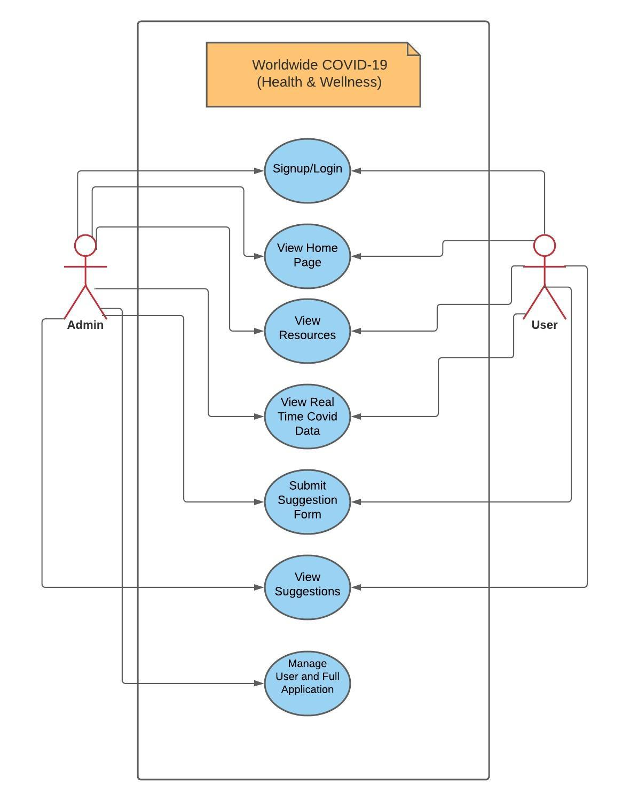
Signup/login
View Home page
View Resources
View Real Time Covid Data
Submit Suggestion Form
View Suggestions
Manage user and full application
Use Case Diagram

Slide 5
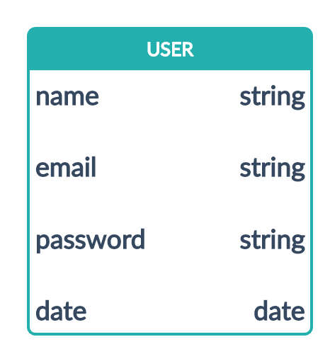
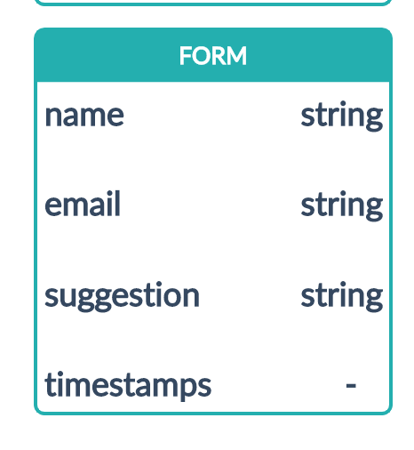
Database Models

Slide 6
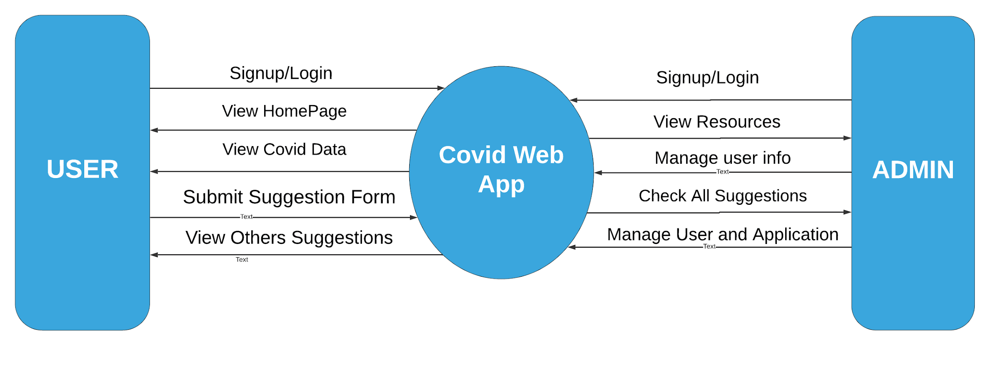
Data Flow Diagram

Slide 7
Hardware:
Laptop/Desktop
1.8 GHz or faster processor. Quad-core or better recommended
4 GB of RAM and core i3 processor
Hard disk space: Minimum of 500MB
Software:
Windows 8.1 and above
Visual Studio Code
Web Browser
Github Desktop
Hardware and Software Requirements

Slide 8
HTML5 MongoDB
CSS3 EJS Templating
Bootstrap 4 / 5
JavaScript
NodeJS
ExpressJs
Technologies Used

Slide 9
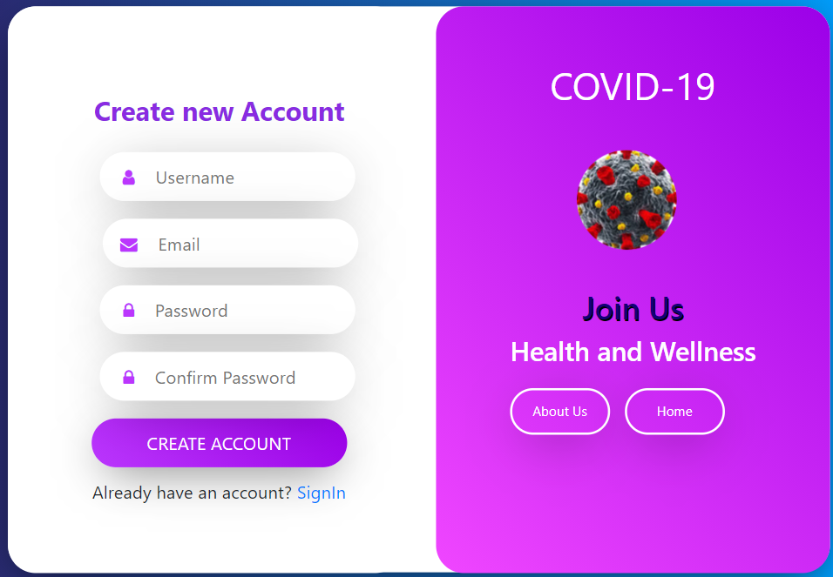
Screenshots:
Registration
Page

Slide 10
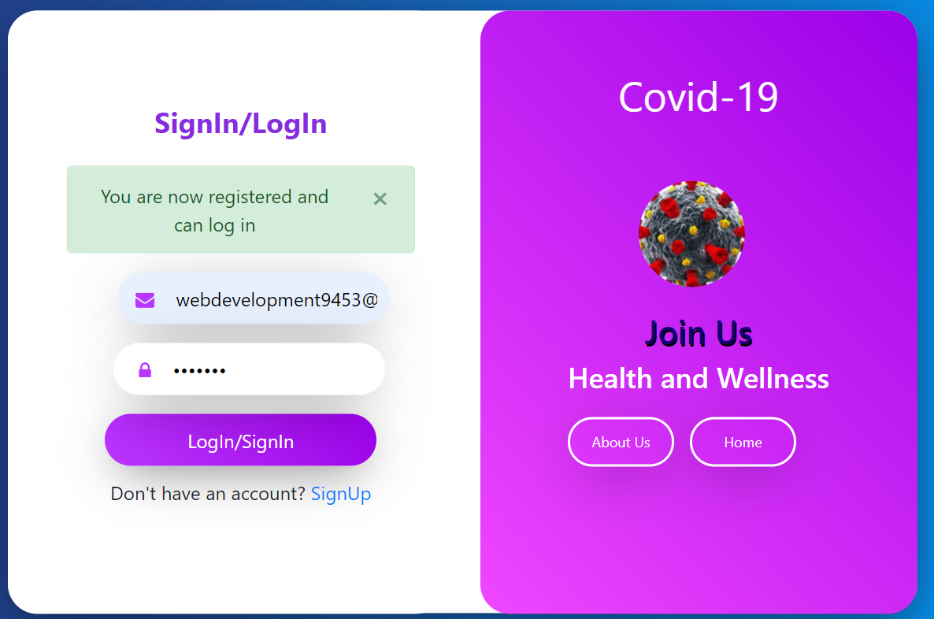
Sign in Page

Slide 11
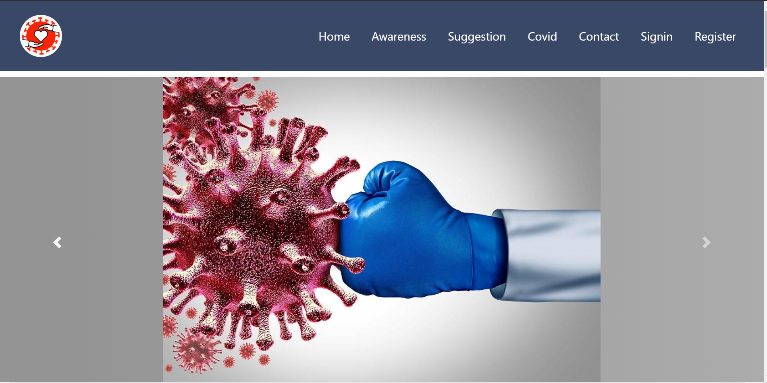
Home Page

Slide 12
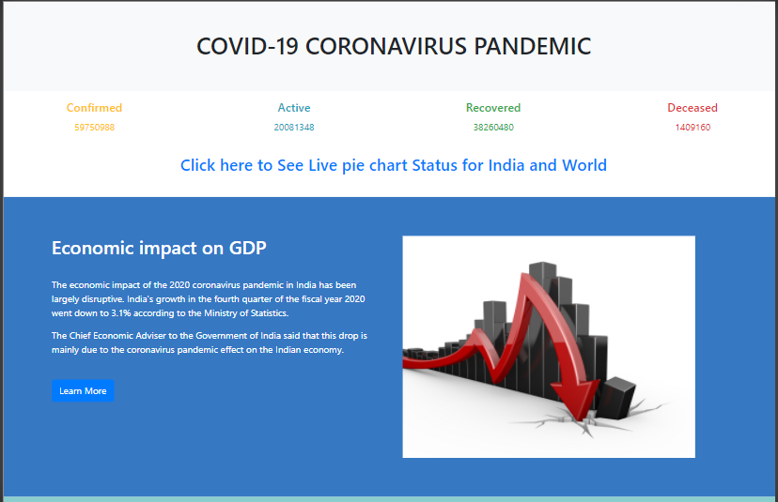

Slide 13
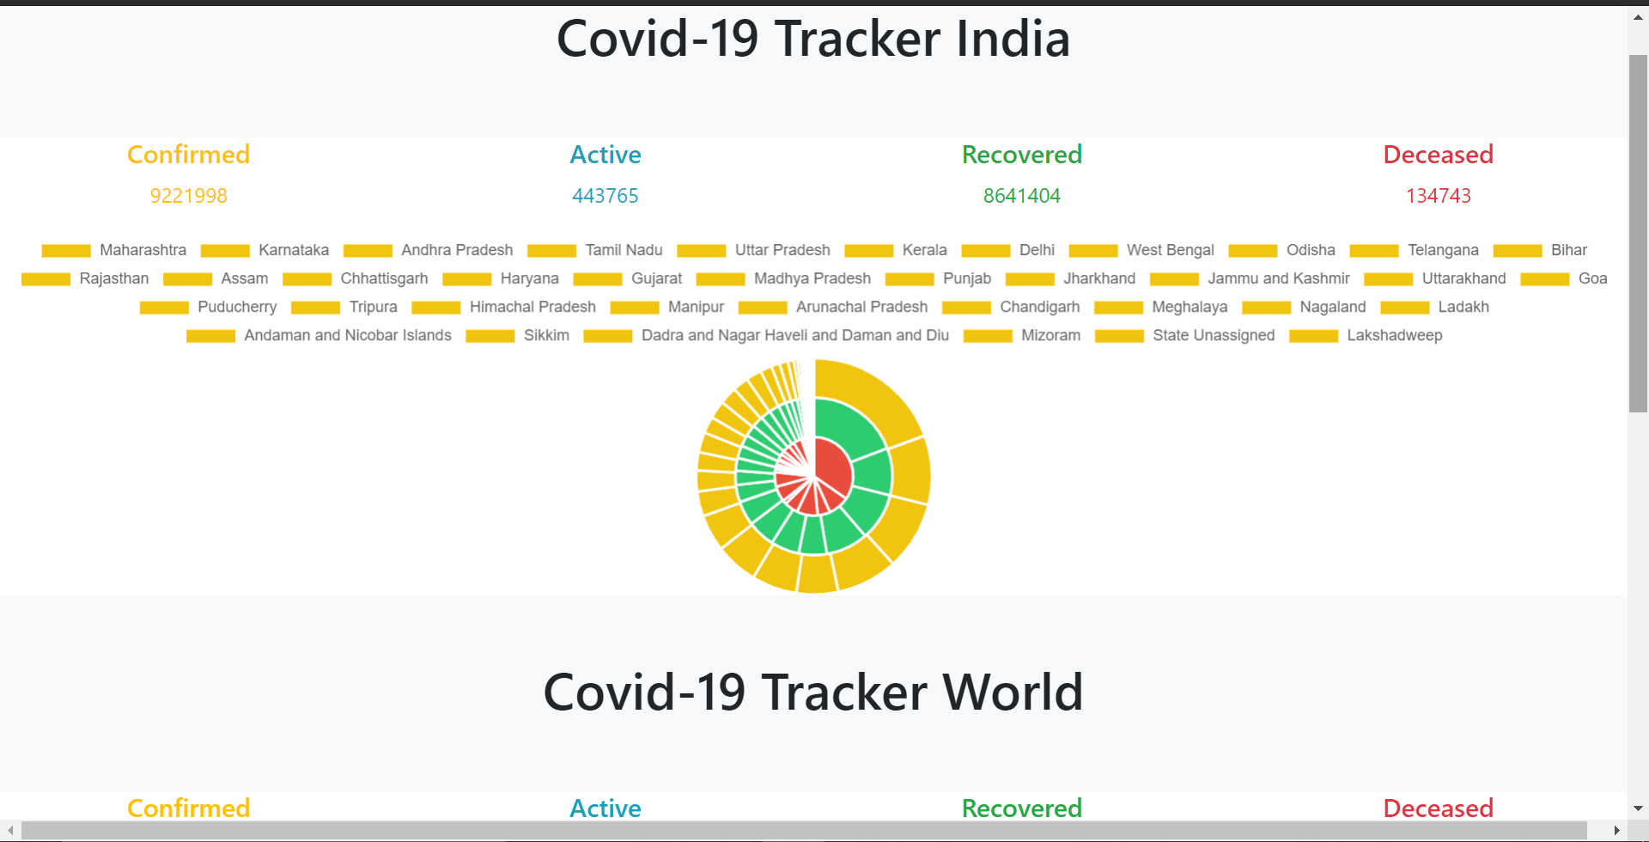

Slide 14
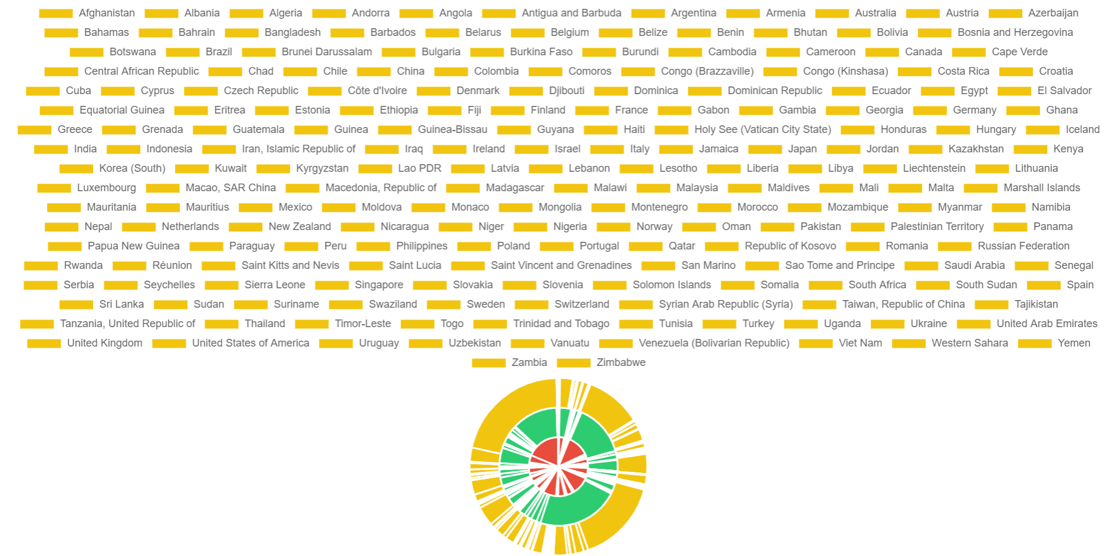
Worldwide Pie Chart

Slide 15
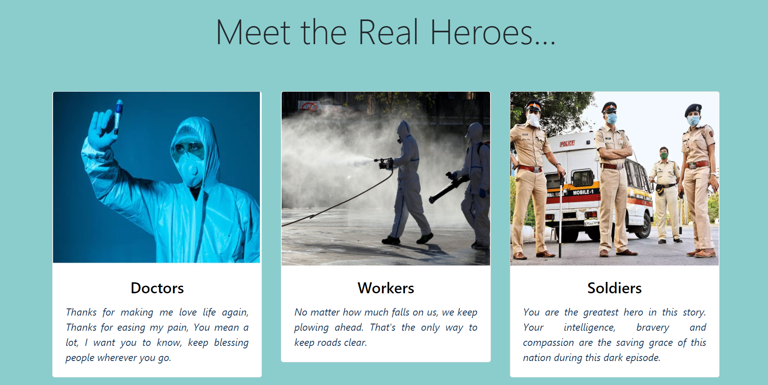
Meet Section

Slide 16
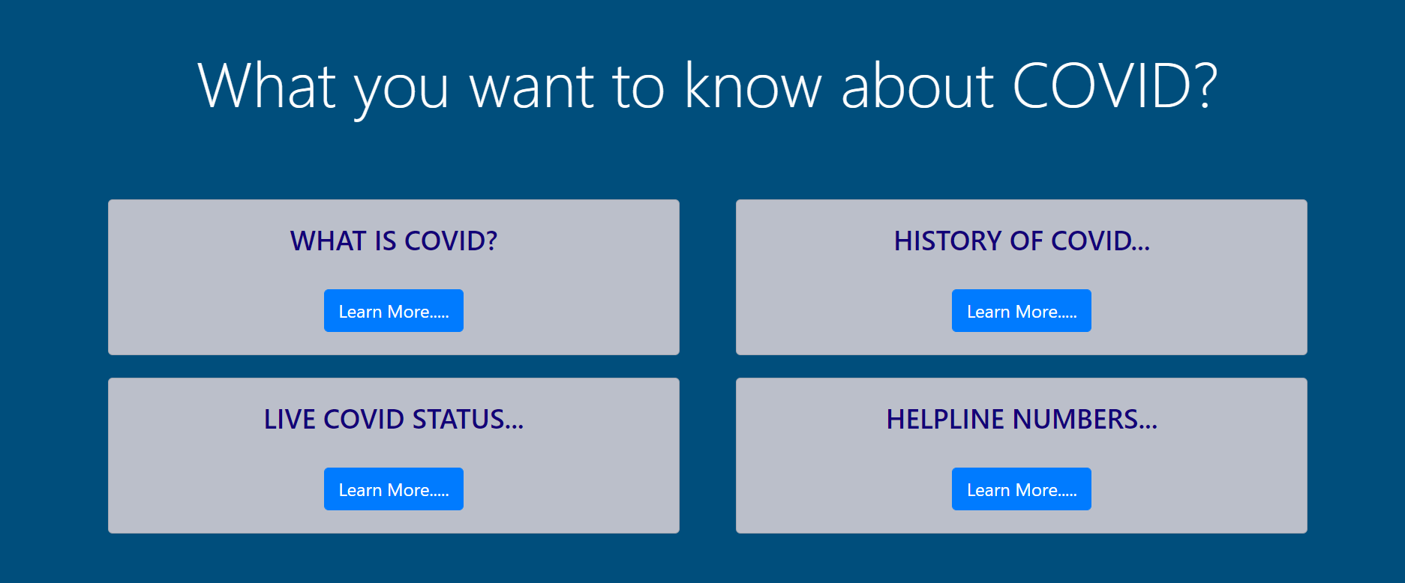
COVID Detailed Section

Slide 17
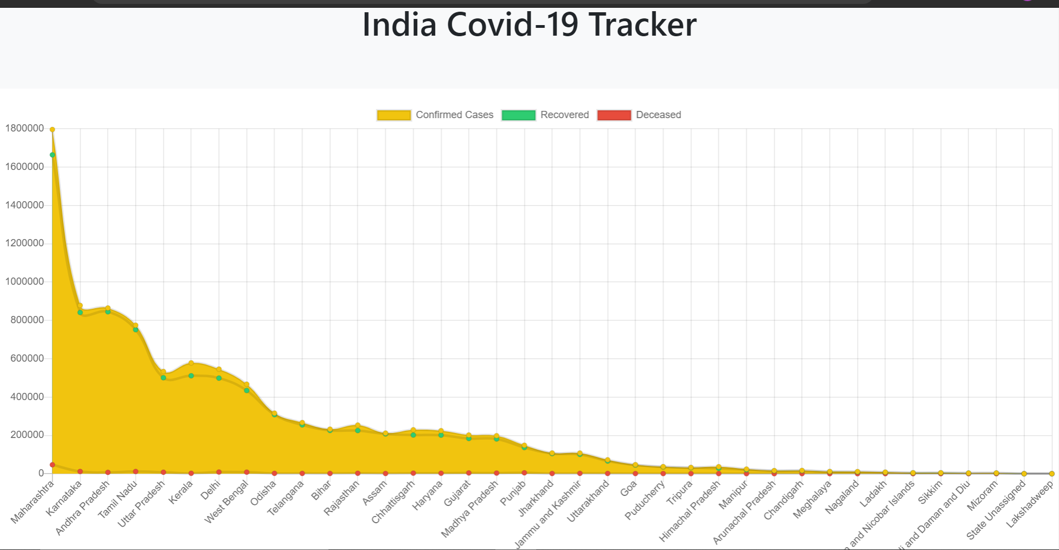
Real Time Chart for India

Slide 18
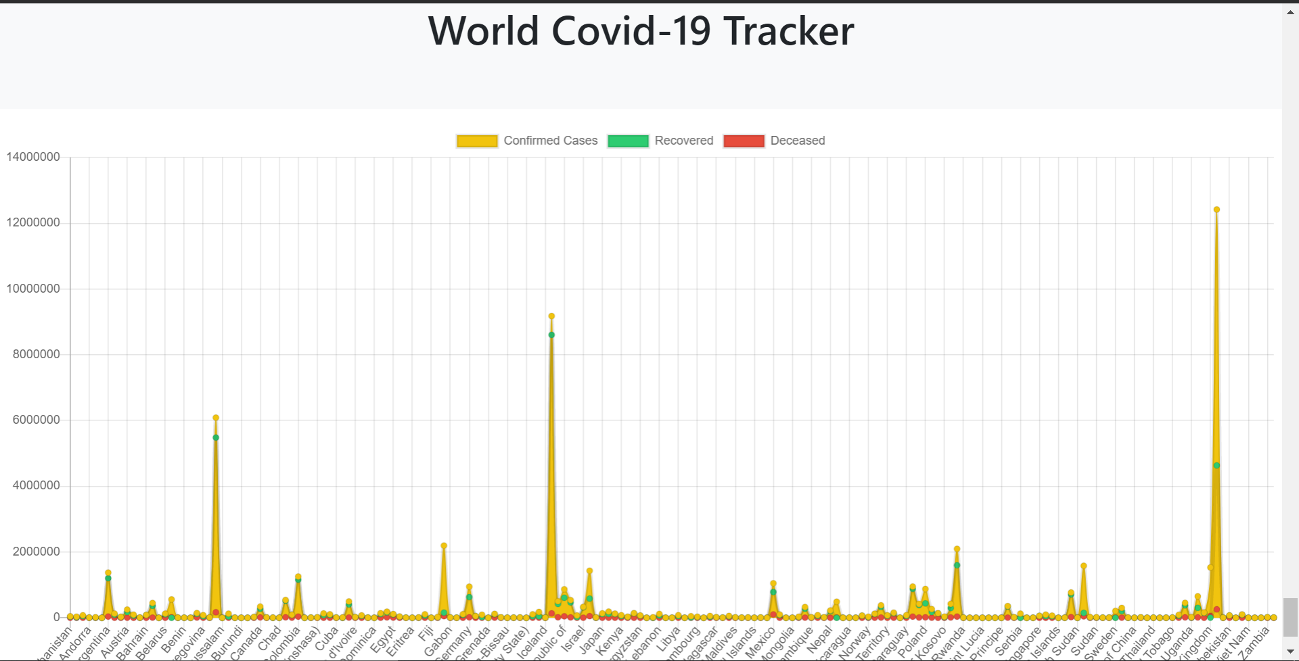
Real Time Chart for World

Slide 19
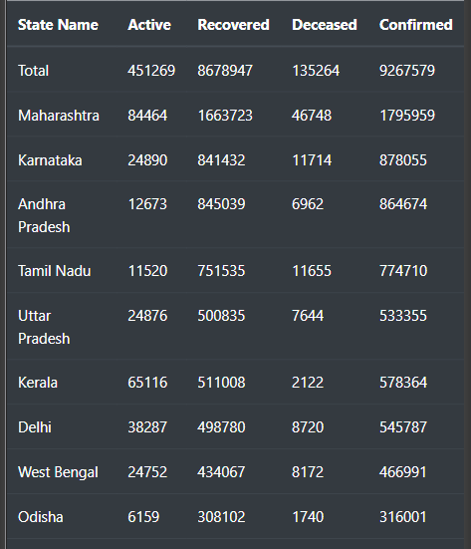
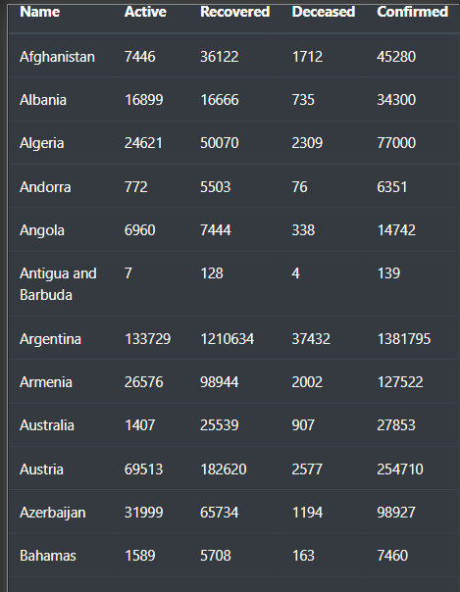
State wise Data for India Country wise Data

Slide 20
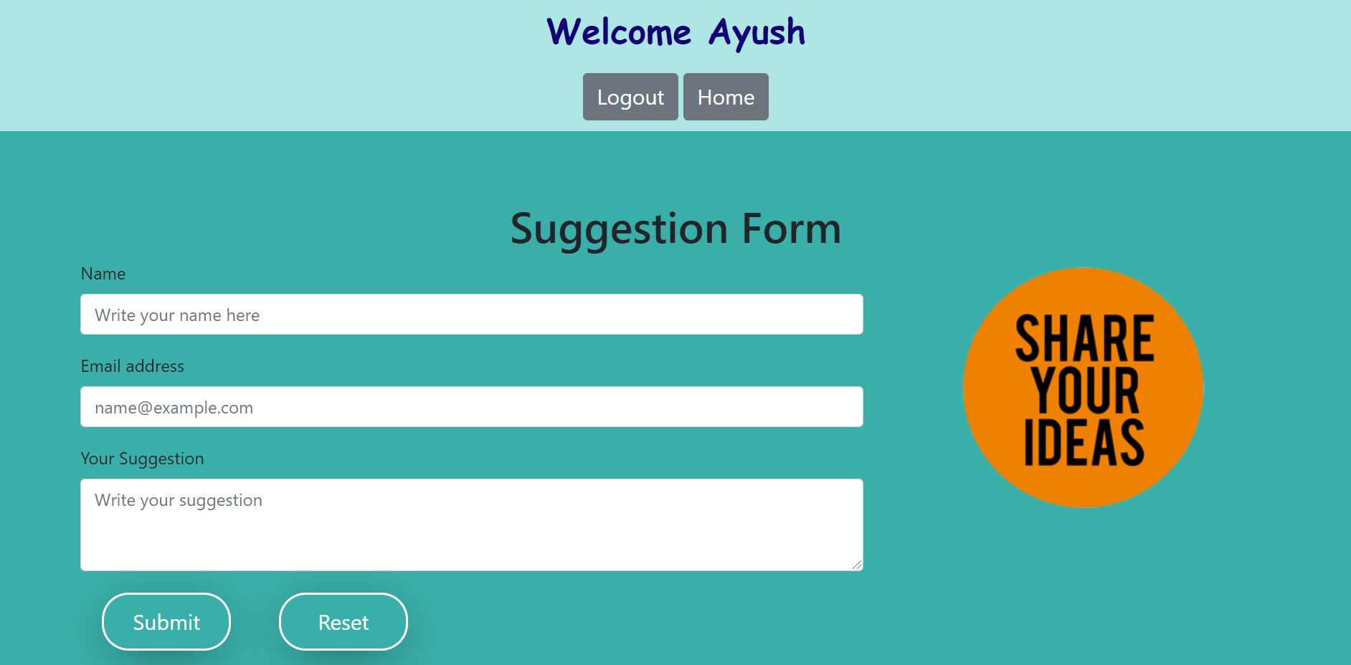

Slide 21
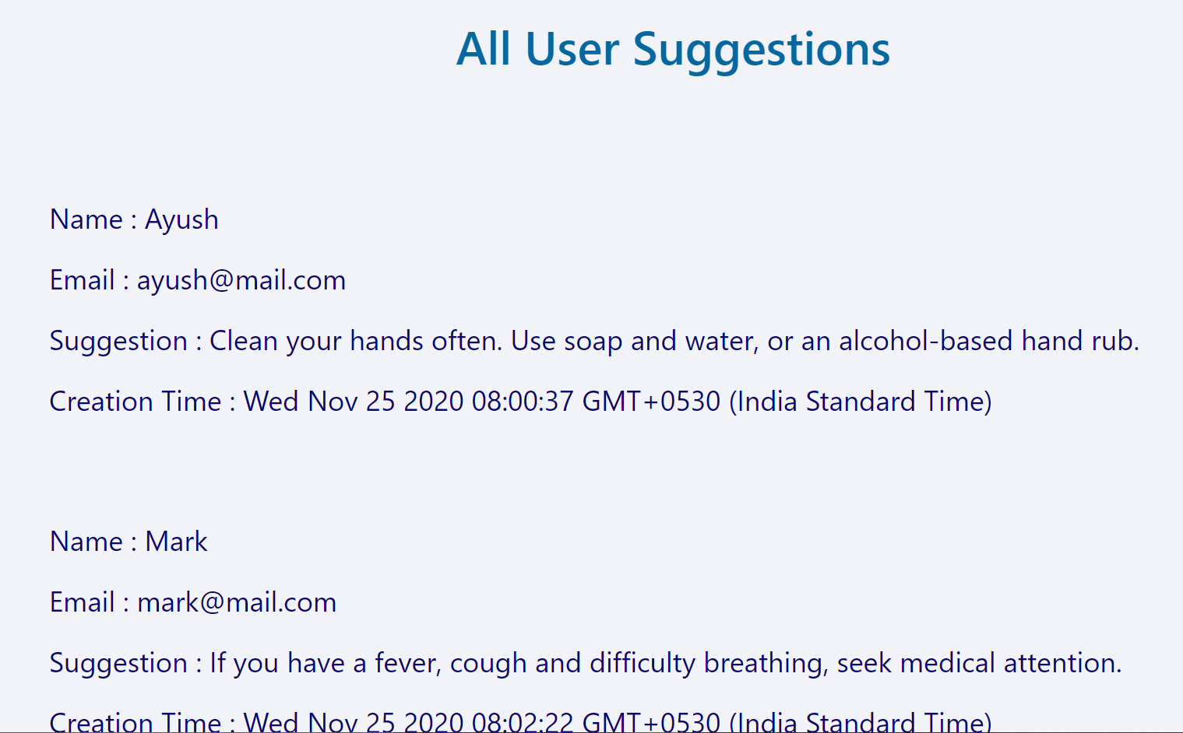

Slide 22

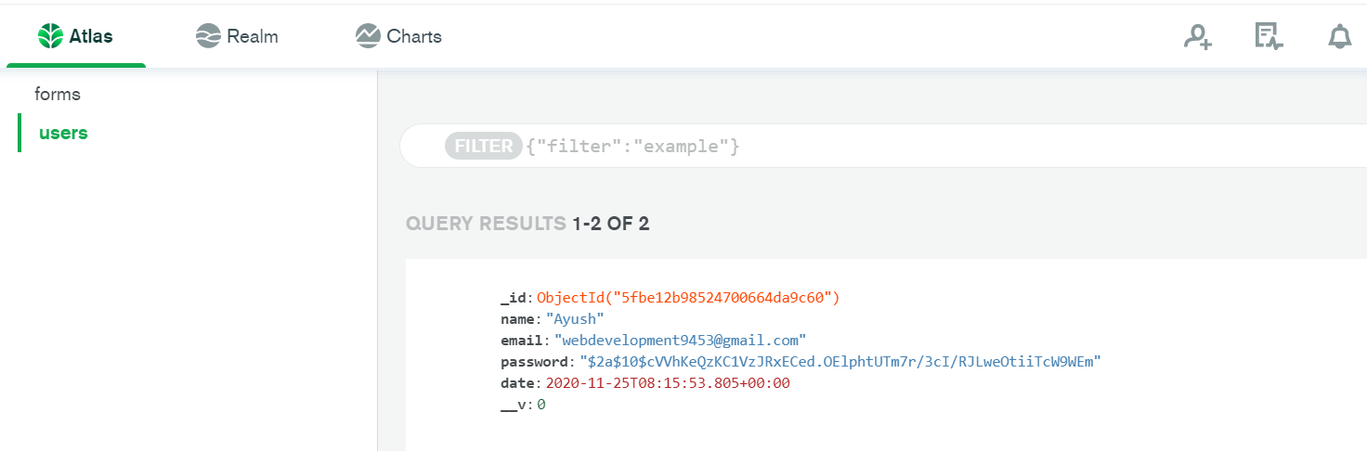
Registered User Data:
Database:

Slide 23
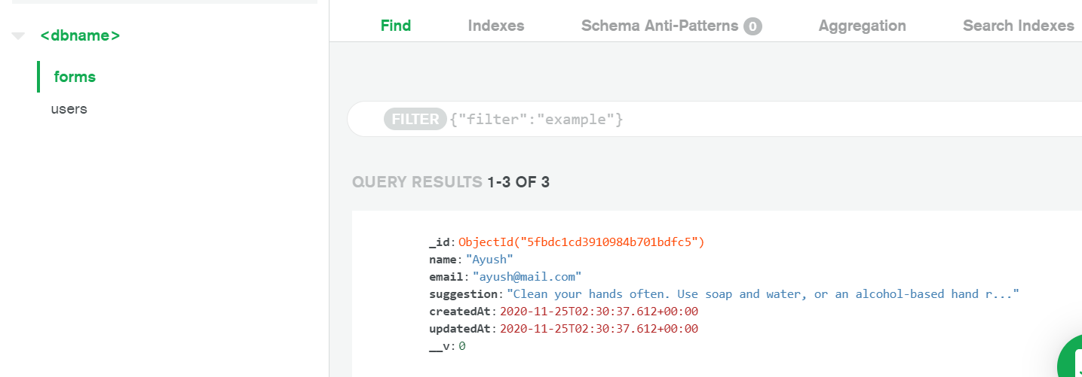
Form Data

Slide 24
Team Worldwide COVID-19
Thank You

